Slide 1
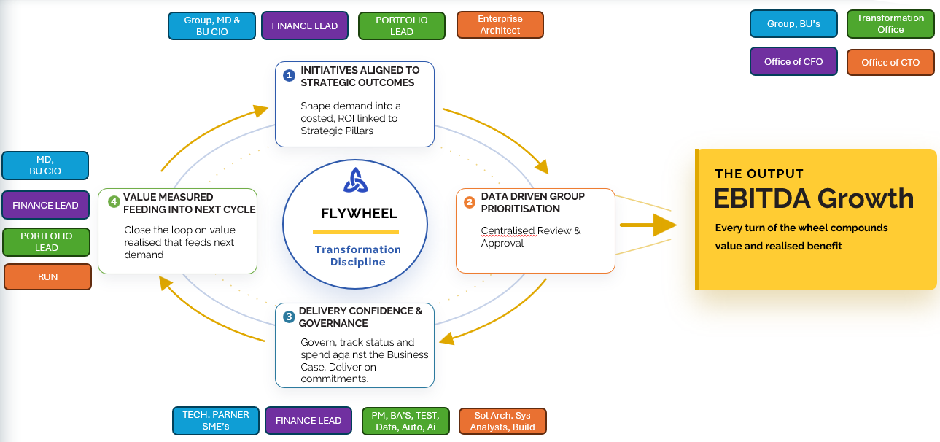
Transformation & Technology Office - TOM
One Technology Organisation, aligned to our Business
with the people and capabilities require to Transform, Build, Change & Run
HOW IT DELIVERS
BUSINESS ENGAGEMENT LAYER - (TRANSFORM) – Focus Pillars: 1, 2, 4
BU CIO’s
Supply Chain & Retail CIO
Medtech CIO
Pharma Services & Global Sourcing CIO
Group Services Portfolio Director
ENTERPRISE SERVICES LAYER - (ORCHESTRATION) – Focus Pillars: 2, 3, 4
Security, Architecture & Engineering – CTO
Shared Services CIO
Portfolio Director
Head of Enterprise Applications
Chief Data & Ai Officer
ENABLEMENT TOWERS LAYER - (BUILD, CHANGE, RUN) – Focus Pillars: 3, 4
Security
Enterprise Architecture
Product & Engineering
Infrastructure
Operations & EUC
Service Management
Project Management
Business Analyst
Test
Business Application Towers
Integration
Data, Automation & Ai
Culture: One Team, Ownership & Accountability, Pace with discipline, Transparency without fear, Challenge & Commit

